Slide 1
WP security and harding techniques
XBI @eamv 09.04.2024

Slide 2
Disclosure
Jeg har undersøgt, at Multimedia Design-studerende kan fortsætte på overbygningsuddannelsen i IT-sikkerhed:
https://www.ug.dk/uddannelser/professionsbacheloruddannelser/overbygningsuddannelser/it-sikkerhed
Dette kunne være en relevant mulighed for dem, der ønsker at specialisere sig inden for cybersikkerhed

Slide 3
Introduction to WordPress Security
WordPress is one of the most popular and widely used platforms for creating websites and blogs. However, this also makes it a target for hackers
WordPress security is important for protecting your website from attacks, preventing data breaches, maintaining your reputation, and ensuring your visitors' trust and satisfaction. WordPress security involves lot of best practices

Slide 4
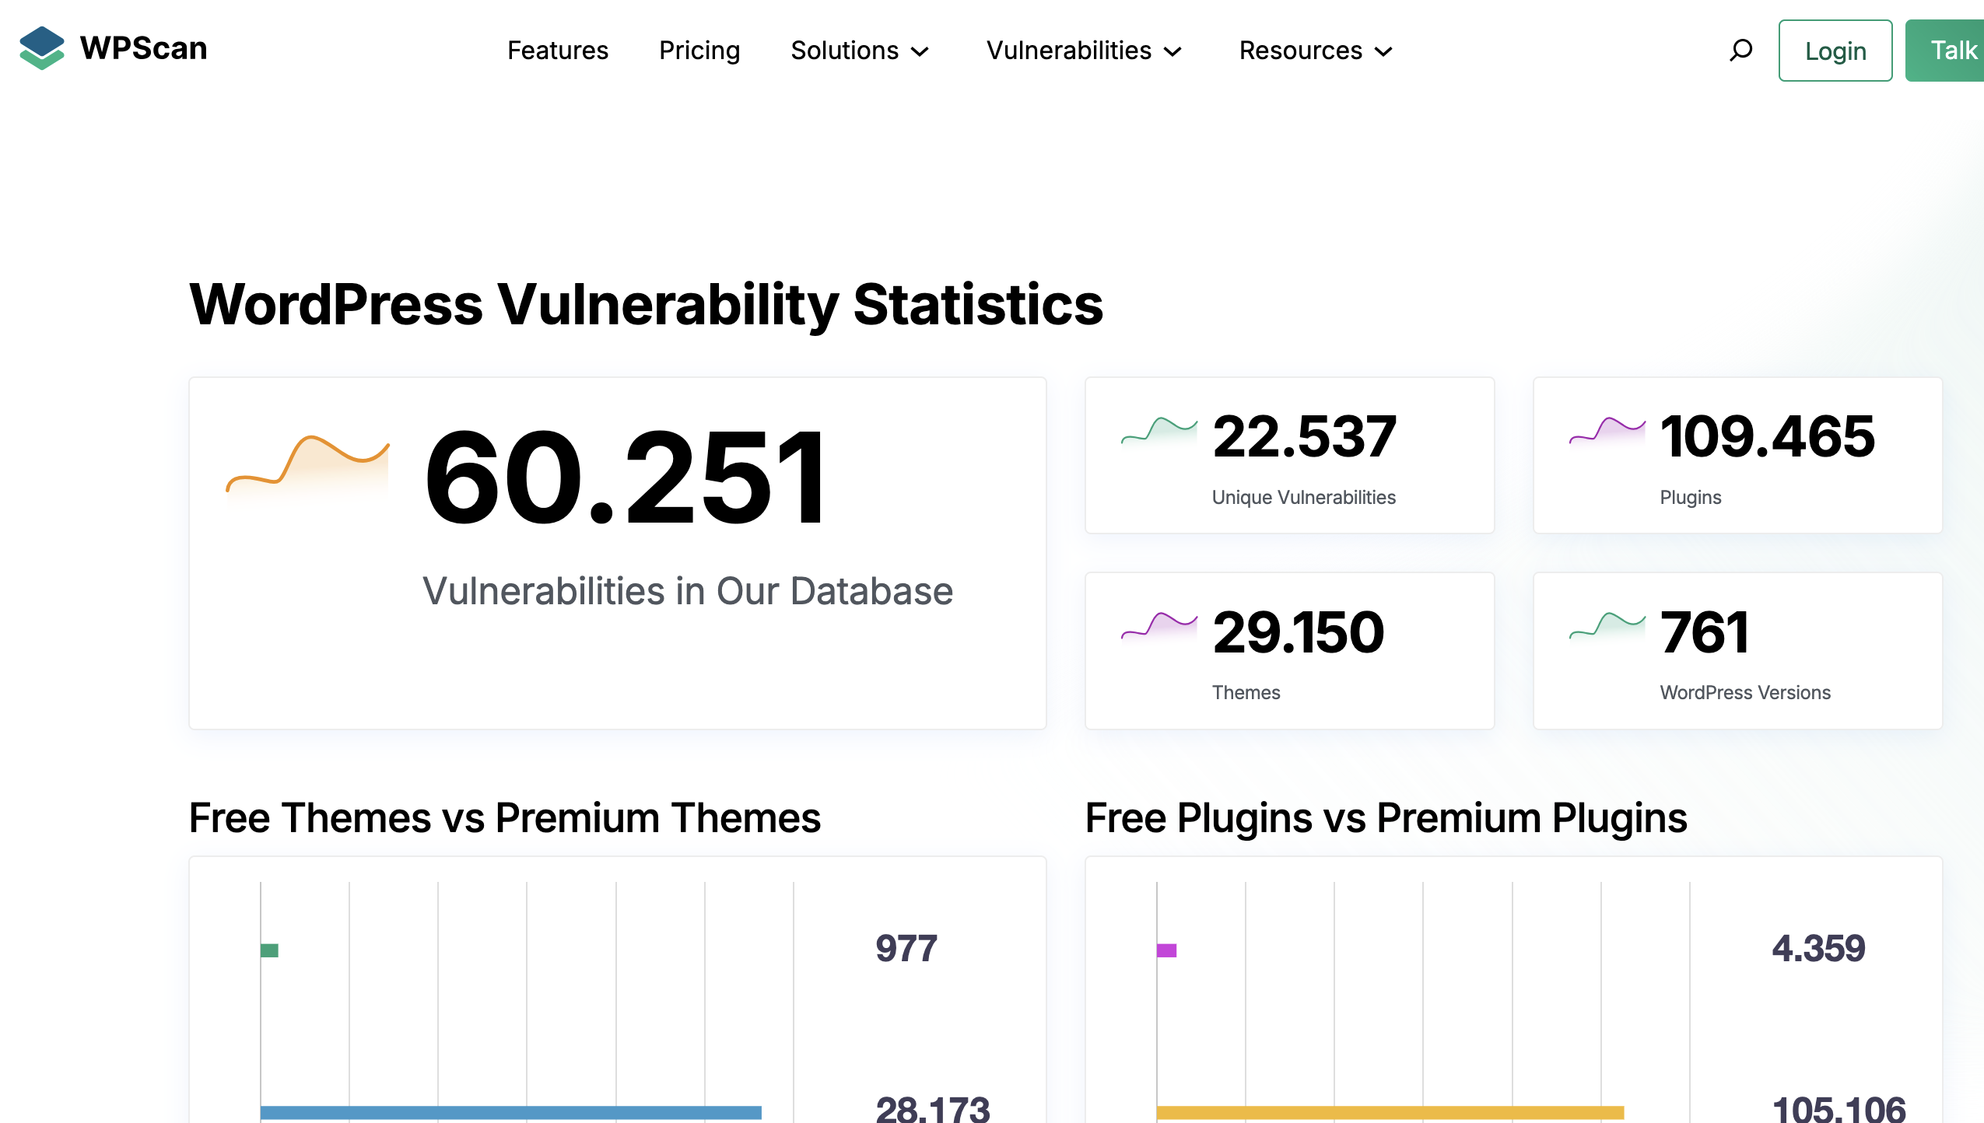
WordPress Vulnerability Statistics
Source: https://wpscan.com/statistics/

Slide 5
Common Vulnerabilities
Outdated software:
Unupdated plugins, themes, and WordPress versions.
Can contain security holes that can be exploited.
Weak passwords:
Easy-to-guess passwords ("123456", "password").
Give hackers access to your website.
Unsecured plugins and themes:
From unofficial sources or with known security vulnerabilities.
Can infect your website with malware.
source: https://blog.hubspot.com/website/wordpress-security-issues

Slide 6
Consequences of Vulnerabilities
Malware infections:
Viruses, trojan horses, ransomware.
Can damage files, steal data, and disrupt functionality.
Data theft:
Passwords, customer information, personal data.
Can lead to identity theft and financial losses.
Website crashes:
Unusable for visitors and can damage reputation.
Loss of income and productivity.

Slide 7
WordPress Security Threats
Malware infections. Attackers can infect your site with malware to gain control over user devices or steal sensitive information.
Structured Query Language (SQL) attacks. This type of attack uses SQL queries to try to gain access to the database and its information.
Cross-Site Scripting (XSS) attacks. XSS attacks try to “trick” the browser into executing scripts that enable them to hijack user sessions or gain access to information.
Brute force attacks. With this type of attack, malicious actors will try to gain access to the WordPress admin using different combinations of credentials.
https://blog.wpsec.com/4-most-common-wordpress-vulnerabilities-and-how-to-fix-them/

Slide 8
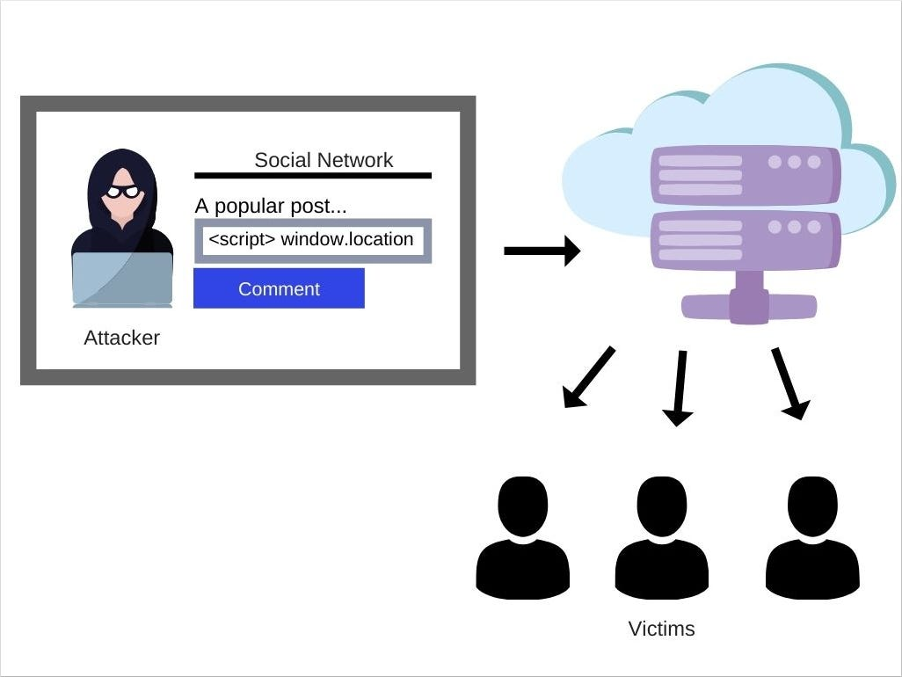
Cross-Site Scripting (XSS) attacks.
Source:
https://miro.medium.com/v2/resize:fit:1026/1*KGAppeqpUwv8OgPKkT0Ujw.jpeg

Slide 9
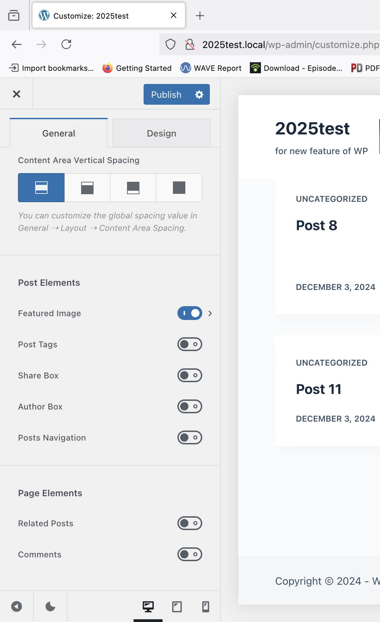
For security Reasons
Disable Post-> comments
Customrize –
Single post
Disable comments

Slide 10
Security Measures
Updating software:
Keep WordPress, plugins, and themes updated.
Install security patches and bug fixes.
Using security plugins:
Offer firewall, malware scanning, login protection, and other features.
Choose reputable plugins with good support.
Strong passwords:
Long, complex passwords with a mix of characters.
Use different passwords for different accounts.

Slide 11
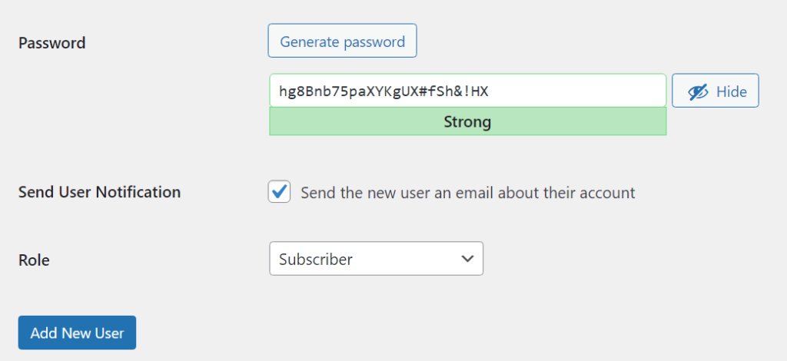
Passwords-setup

Slide 12
Backups
Regular backups:
Of database, files, and themes.
Helps restore the website in case of an attack.
Storing backups off-site:
In separate cloud storage or external hard drive.
Protects against data loss in case of server compromise.
Recover from Simply.com

Slide 13
Two-Factor Authentication (2FA)
How does 2FA work?
Extra security step besides password.
Enter a code from an app or SMS to log in.
Implementing on WordPress:
Available through plugins and security services.
Protects against unauthorized access.

Slide 14
Security WP Plugins
Firewall (Wordfence, Sucuri)
Malware scanning (iThemes Security, SiteGuard)
Login protection (Login Lockdown, Clef)
User activity monitoring (VaultPress, WP Activity Log)

Slide 15
Responsibility and Ethics for your next assignment
Respect others' property:
Do not hack other websites without permission.
Report vulnerabilities responsibly.
Legal behavior:
Follow intellectual property laws and avoid illegal activities.
Reporting vulnerabilities:
Report vulnerabilities to software developers or website owners.
Follow responsible disclosure practices.

Slide 16
WP hardening techniques

Slide 17
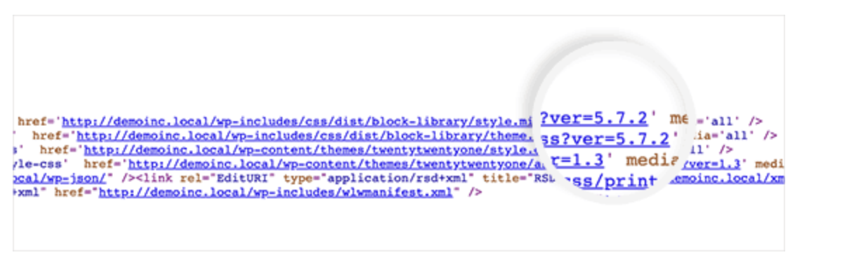
Remove WP version number
https://library.wpcode.com/snippet/m5ygjq5d/

Slide 18
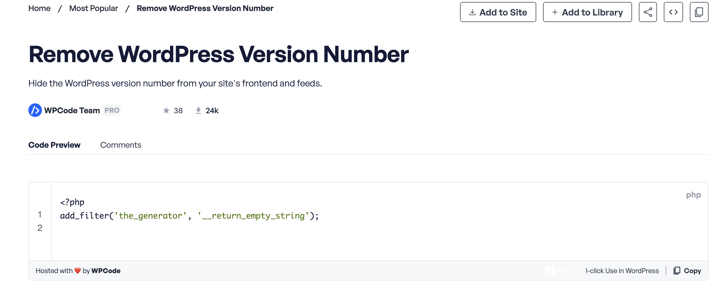
Use code snippes

Slide 19
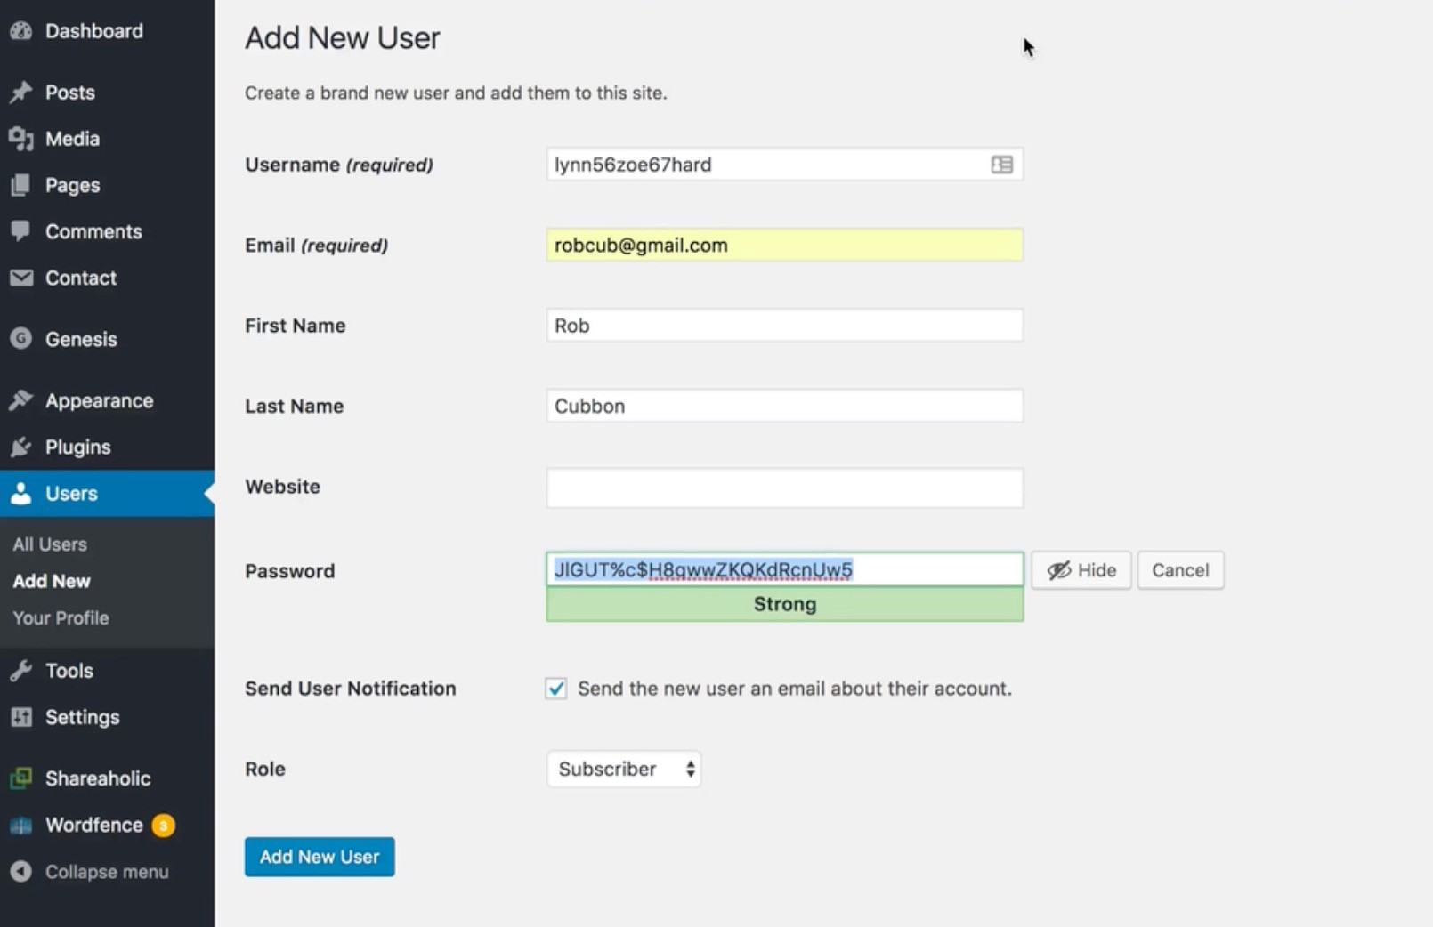
Select a good password for admin user

Slide 20
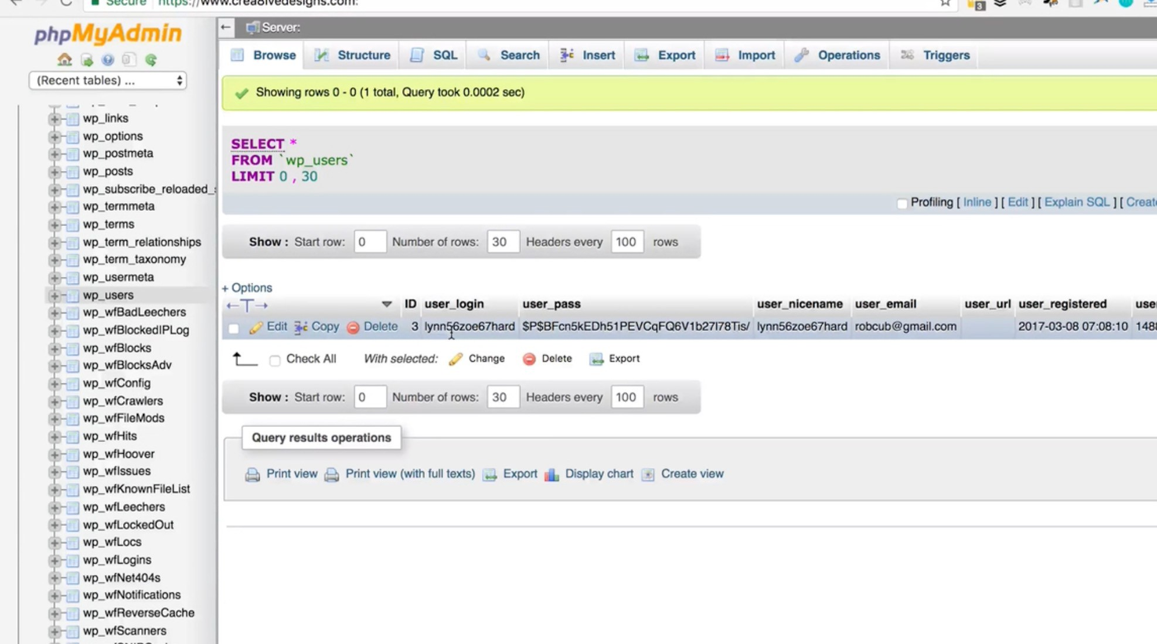
Double Check in DB your admin user name

Slide 21
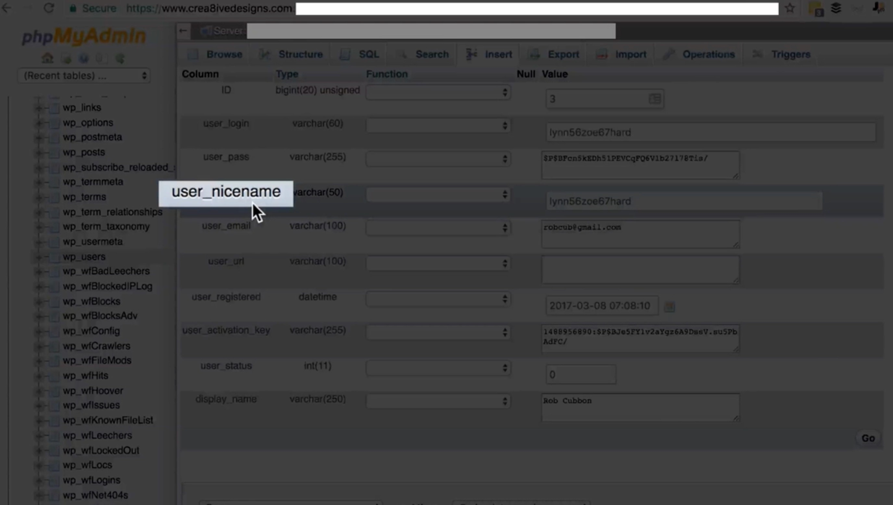
Change user display and nicename in DB

Slide 22


Slide 23
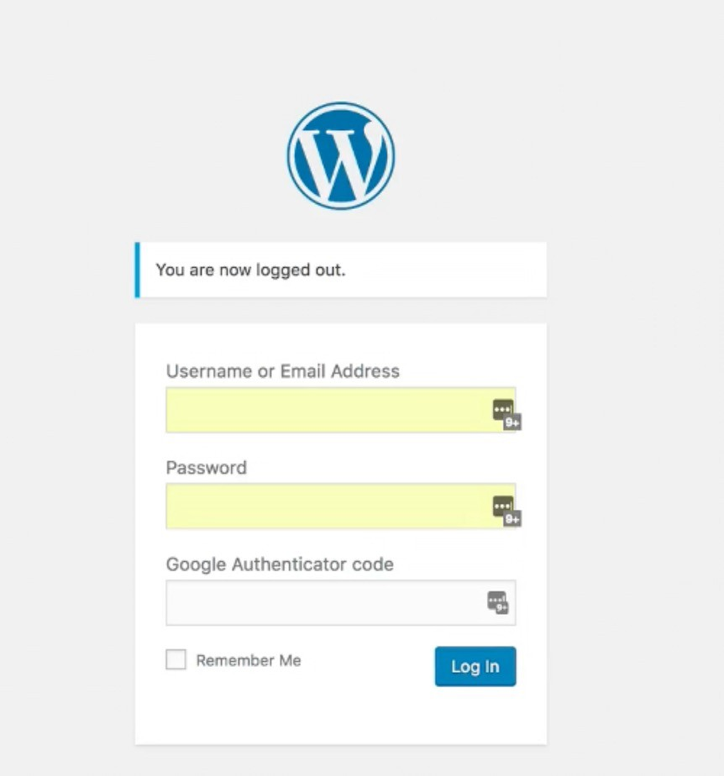
WP Fence plugins

Slide 24
Keep ur WP update
Deleting Unnecessary Plug-ins
Deleting Unnecessary Themes

Slide 25
Accessing your websites files
via a Control Panel, such as cPanel make sure you are accessing the site through a secure SSL connection

Slide 26
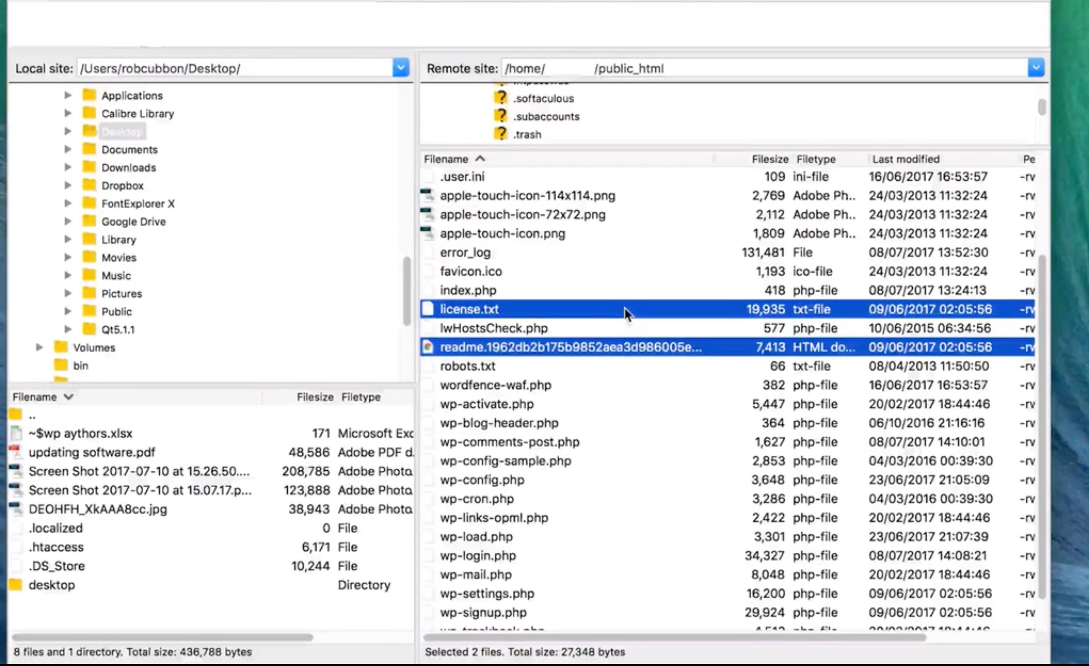
Remove unnessary files

Slide 27
Remember to save
.htacess file before editing it

Slide 28
Edit in .htaccess files
Search
disable directory listing apache https://www.simplified.guide/apache/disable-directory-listing

Slide 29
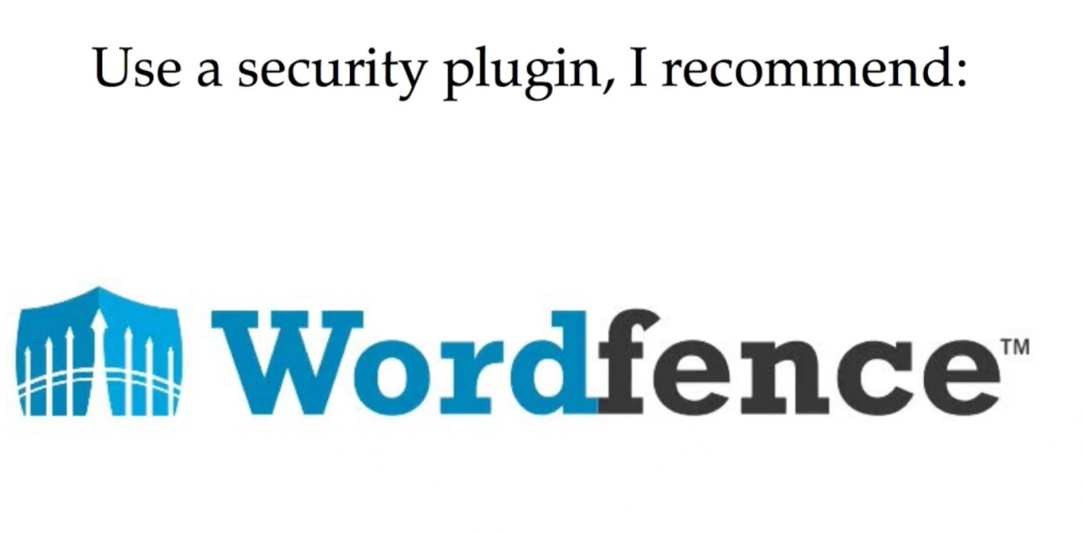

Slide 30
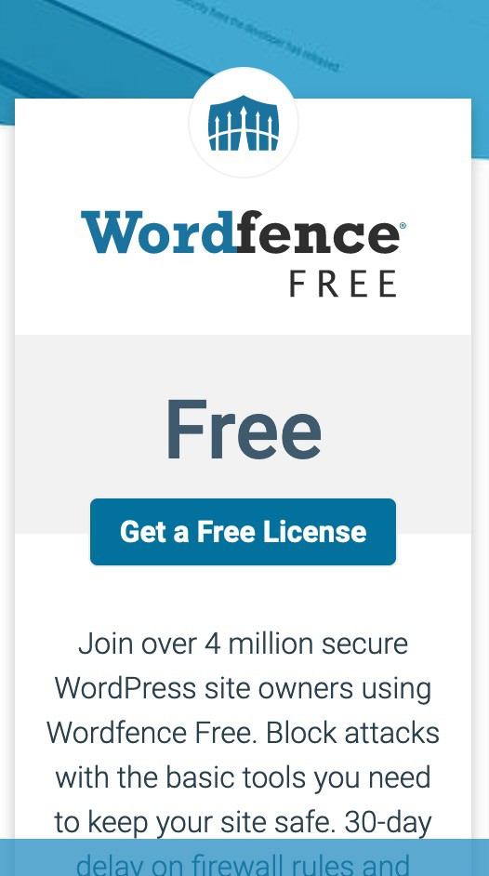
Choose a free licence

Slide 31
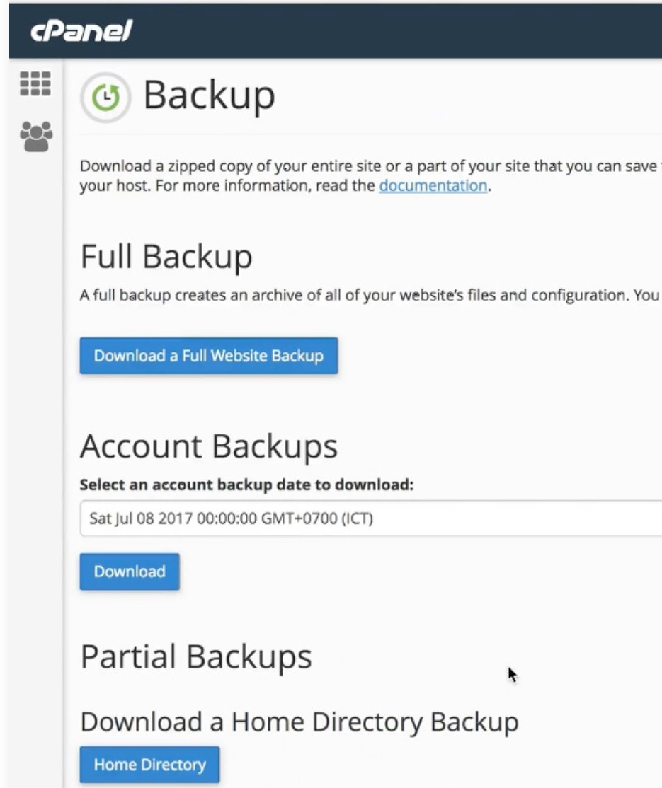
Backups from host

Slide 32
Demo, in xbi local
Scanning
Settings
…

Slide 33
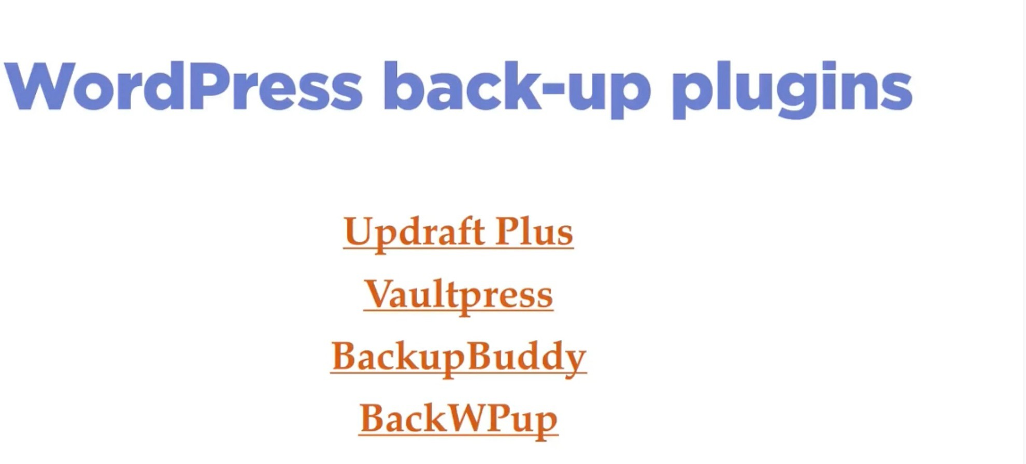
Backup plugins

Slide 34
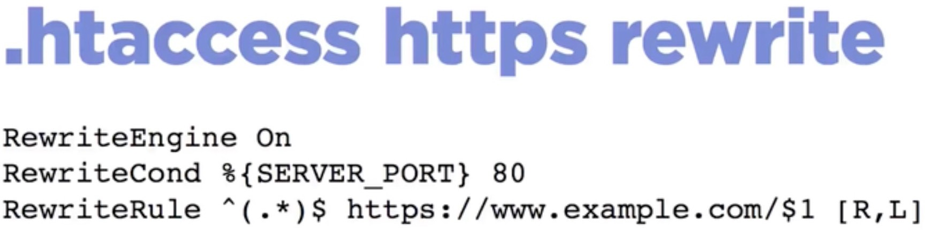

Slide 35
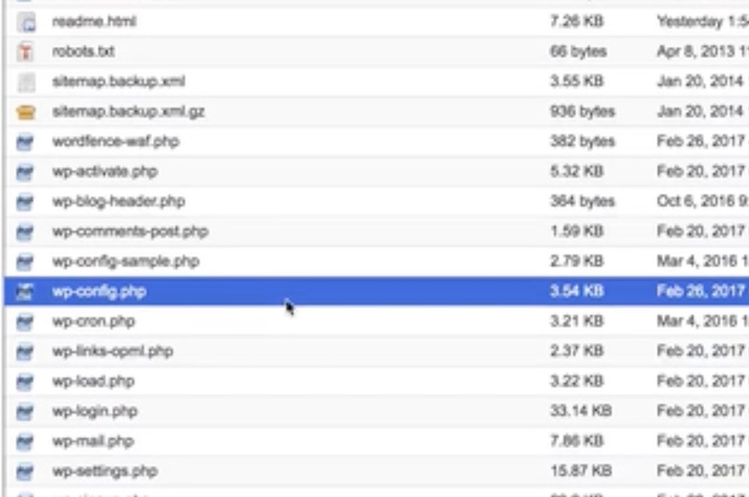
How to Hide Warnings and Disable PHP Errors in WordPress

Slide 36
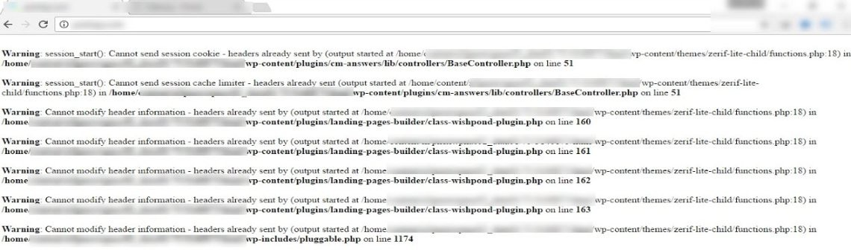
Php warning- why we want to hide it?

Slide 37
WP-config.php
Open Your wp-config. php File. ...
Replace the Debug Lines. Replace the existing lines with the following code snippet: ini_set('display_errors','Off'); ini_set('error_reporting', E_ALL ); define('WP_DEBUG', false); define('WP_DEBUG_DISPLAY', false);
Save and Upload.
https://www.google.com/search?q=Disable+error+reporting+in+wp+configure+wordpress&source=lmns&bih=929&bi

Slide 38
Disable editing in WP dashboard
Edit in WP-config.php
https://help.one.com/hc/en-us/articles/360002104398-Disable-file- editing-in-WordPress-admin

Slide 39
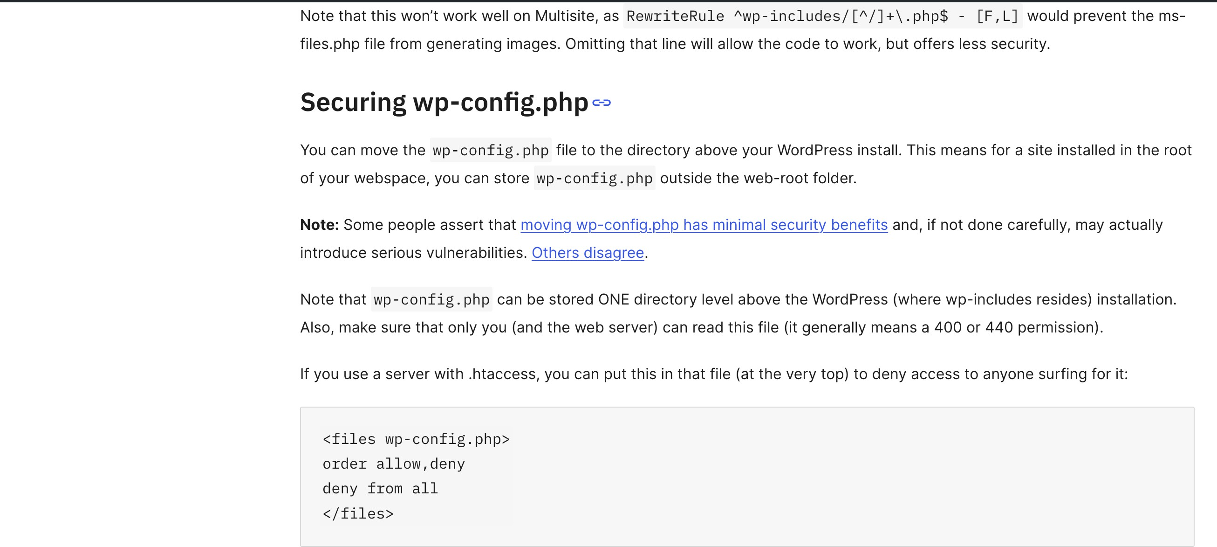
Protect the WP-config.php file

Slide 40
Source and reference
https://www.udemy.com/course/wordpress-security-secure-your-site- against-hackers/
https://developer.wordpress.org/advanced- administration/security/hardening/
https://wordpress.org/plugins/wps-hide-login/

